Slide 1

Sons of the American Legion
VETERANS EMPLOYMENT and EDUCATION COMMISSION
What is it and why is it important?

Slide 2
The American Legion Structure -
Veterans Employment & Education Division
The Veterans Employment & Education Division is responsible for ensuring that U.S. veterans have the opportunity to provide, with honor and dignity, the economic necessities of life for themselves and their families.

Slide 3
The American Legion Structure (cont.)
Veterans Employment & Education Commission
Purpose
To supervise and coordinate all activities of committees assigned to the Veterans Employment & Education Commission;
When necessary, to initiate action concerning all matters affecting the economic well-being of veterans and/or the re-establishment of all war veterans returning to civilian life after a period of active service in the Armed Forces of the United States;
To keep the National Commander and the National Executive Committee informed concerning all developments affecting the economic welfare of veterans in all areas under the jurisdiction of the Veterans Employment & Education Commission;
Such other purposes as may be assigned to it by the National Executive Committee.

Slide 4
The American Legion Structure (cont.)
Veterans Employment & Education Committees:
Employment & Veterans Preference Committee
Veterans Education, Other Benefits & Homelessness Committee
Veterans Employment and Education deals with programs involving veteran’s education, small business, employment, veteran’s preference, VA home loans, homeless veterans, training, licensing and certification, transition, USERRA, and other issues related to economics

Slide 5
S.A.L. VE&E Commission MISSION STATEMENT
“To assist The American Legion in ensuring that America’s Veterans have the opportunity to provide, with honor and dignity, the economic necessities of life for themselves and their families”.

Slide 6
How Can YOU Make a Difference
As a leader in your Detachment, encourage the creation of a Veterans Employment and Education Committee or a Sub-committee under VA&R

Slide 7
The American Legion National Veterans Employment & Education Commission is still requesting that all Detachments form their own VE&E Committees/Commissions and then request that their Districts and Squadrons do the same. Several Detachments have already done so and we thank you.
These Committees can then assist us by going online and finding local job fairs being held in your states and communities. Then take this info, as well as info received from National HQ, and place it on your websites and Facebook pages and in your newsletters. You can also print out fliers that advertise these job fairs and post them on the bulletin board at your Posts and in other locations around your community where local Veterans will see them.

Slide 8
In addition, We are sure that you will agree that no Veteran should ever be homeless. However, Veterans Homelessness does exist in all corners of our nation.
First Responders are often times in contact with these down on their luck Veterans on a daily basis. The VA has created a brochure to assist these First Responders in dealing with and assisting these homeless Veterans.
The VE&E Commission is requesting everyone to print out and make copies of this 2- sided brochure at:
www.va.gov/homeless/docs/VA_Homeless_Brochure_FirstResponder.pdf
Then make contact with your local Police & Fire Departments to see if they would be willing to place a copy in each of their vehicles.

Slide 9
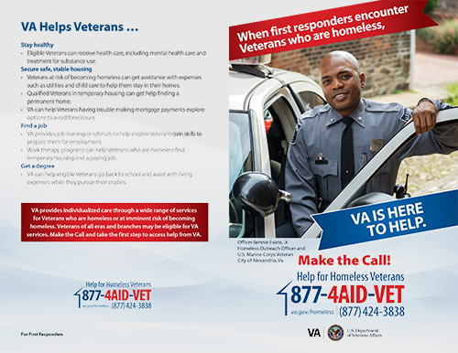
www.va.goc\homeless (Click on Get Involved, Outreach)

Slide 10
The creation of a Veterans Employment and Education Committee (or Sub-committee) within a Detachment can greatly benefit the Sons of The American Legion. While VE&E and VA&R are closely tied and often associated together, they cover different issues America’s veterans are facing.
Veterans Affairs and Rehabilitation
  Program Outline
    I . Volunteer Services
    II. Support Military Troops
      A. USO
      B. Squadron/Individual Support (Phone cards, Care Packages)
      C. POW/MIA Issues
      D. The American Legion Operation Comfort Warrior
      E. My Healthy Vet III.
    Collaborative Program Efforts
      A. National Veterans Assistance Day
      B. Fisher House
      C. Veterans Suicide Prevention as well as other programs
.

Slide 11
Veterans Employment and Education
  Veterans Education
  Small Business
  Employment
  Veteran’s Preference
  VA Home Loans
  Homeless Veterans
  Training
  Licensing and Certifications
  Transition
  USERRA (Uniformed Services Employment and Reemployment Act)
  And other issues related to Economics
  As you can see, there is too much ground to cover by only one committee/commission

Slide 12
SOME EXAMPLES OF ve&e IN ACTION ACROSS
OUR DETACHMENTS
.

Slide 13
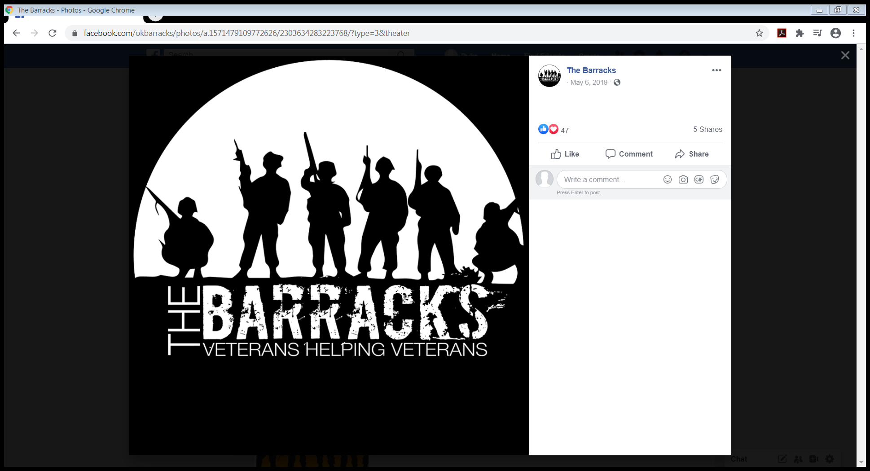

Slide 14
“THE BARRACKS” IN MUSKOGEE, OK IS A PLACE THAT PROVIDES EDUCATIONAL RESOURCES, JOB TRAINING AND SHELTER FOR VETERANS
.

Slide 15
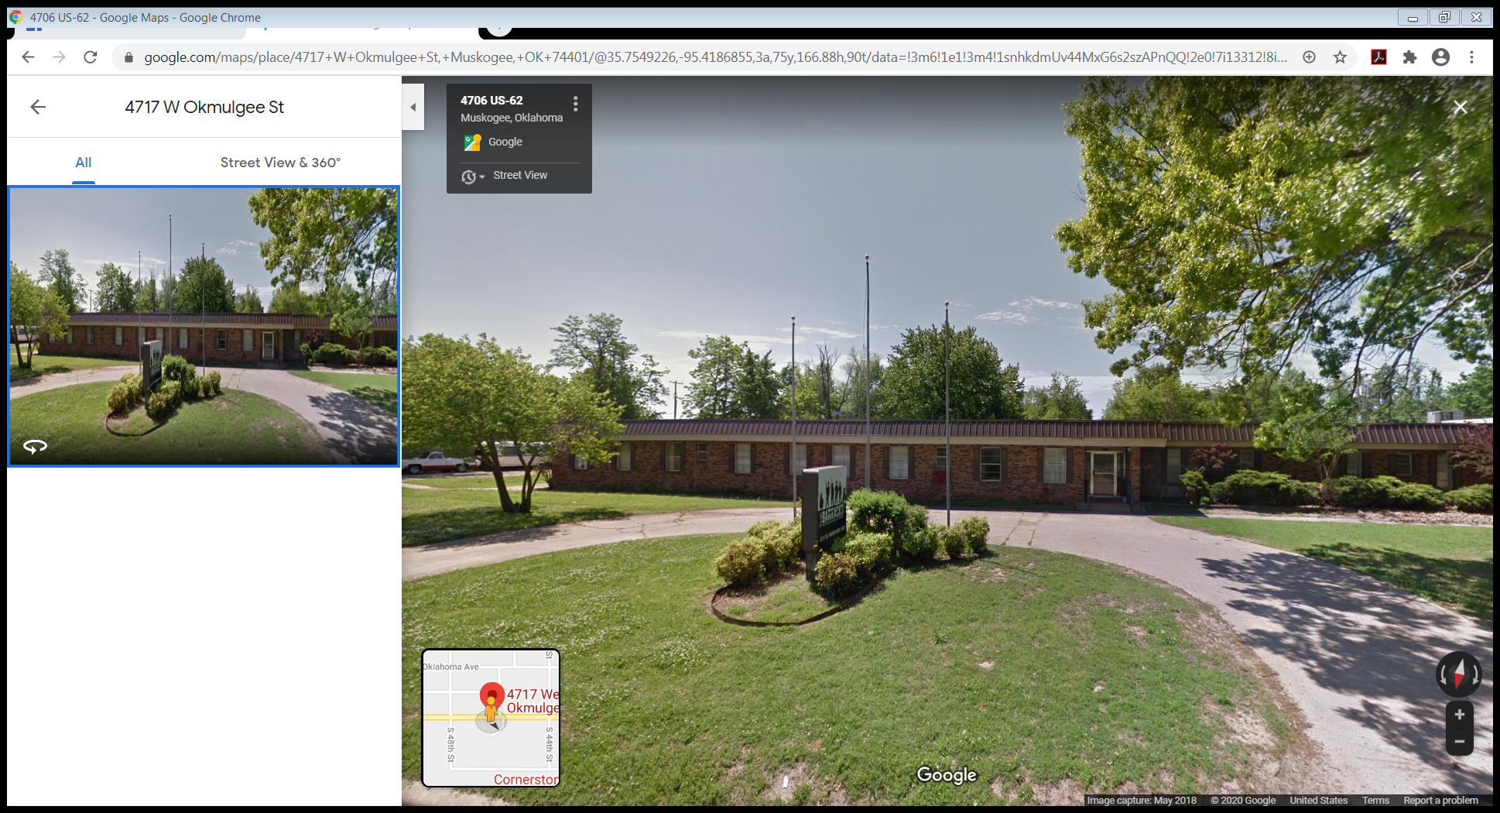

Slide 16
SONS OF THE AMERICAN LEGION DETACHMENT OF WISCONSIN CAMPOUT IN A MAKESHIFT HOMELESS AREA TO RAISE AWARENESS AND MONEY FOR HOMELESS VETERANS
.

Slide 17
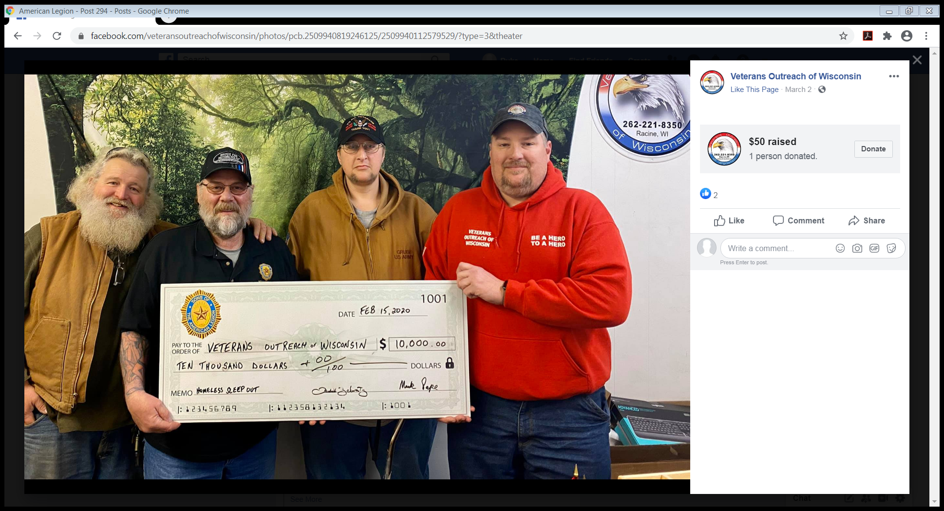

Slide 18
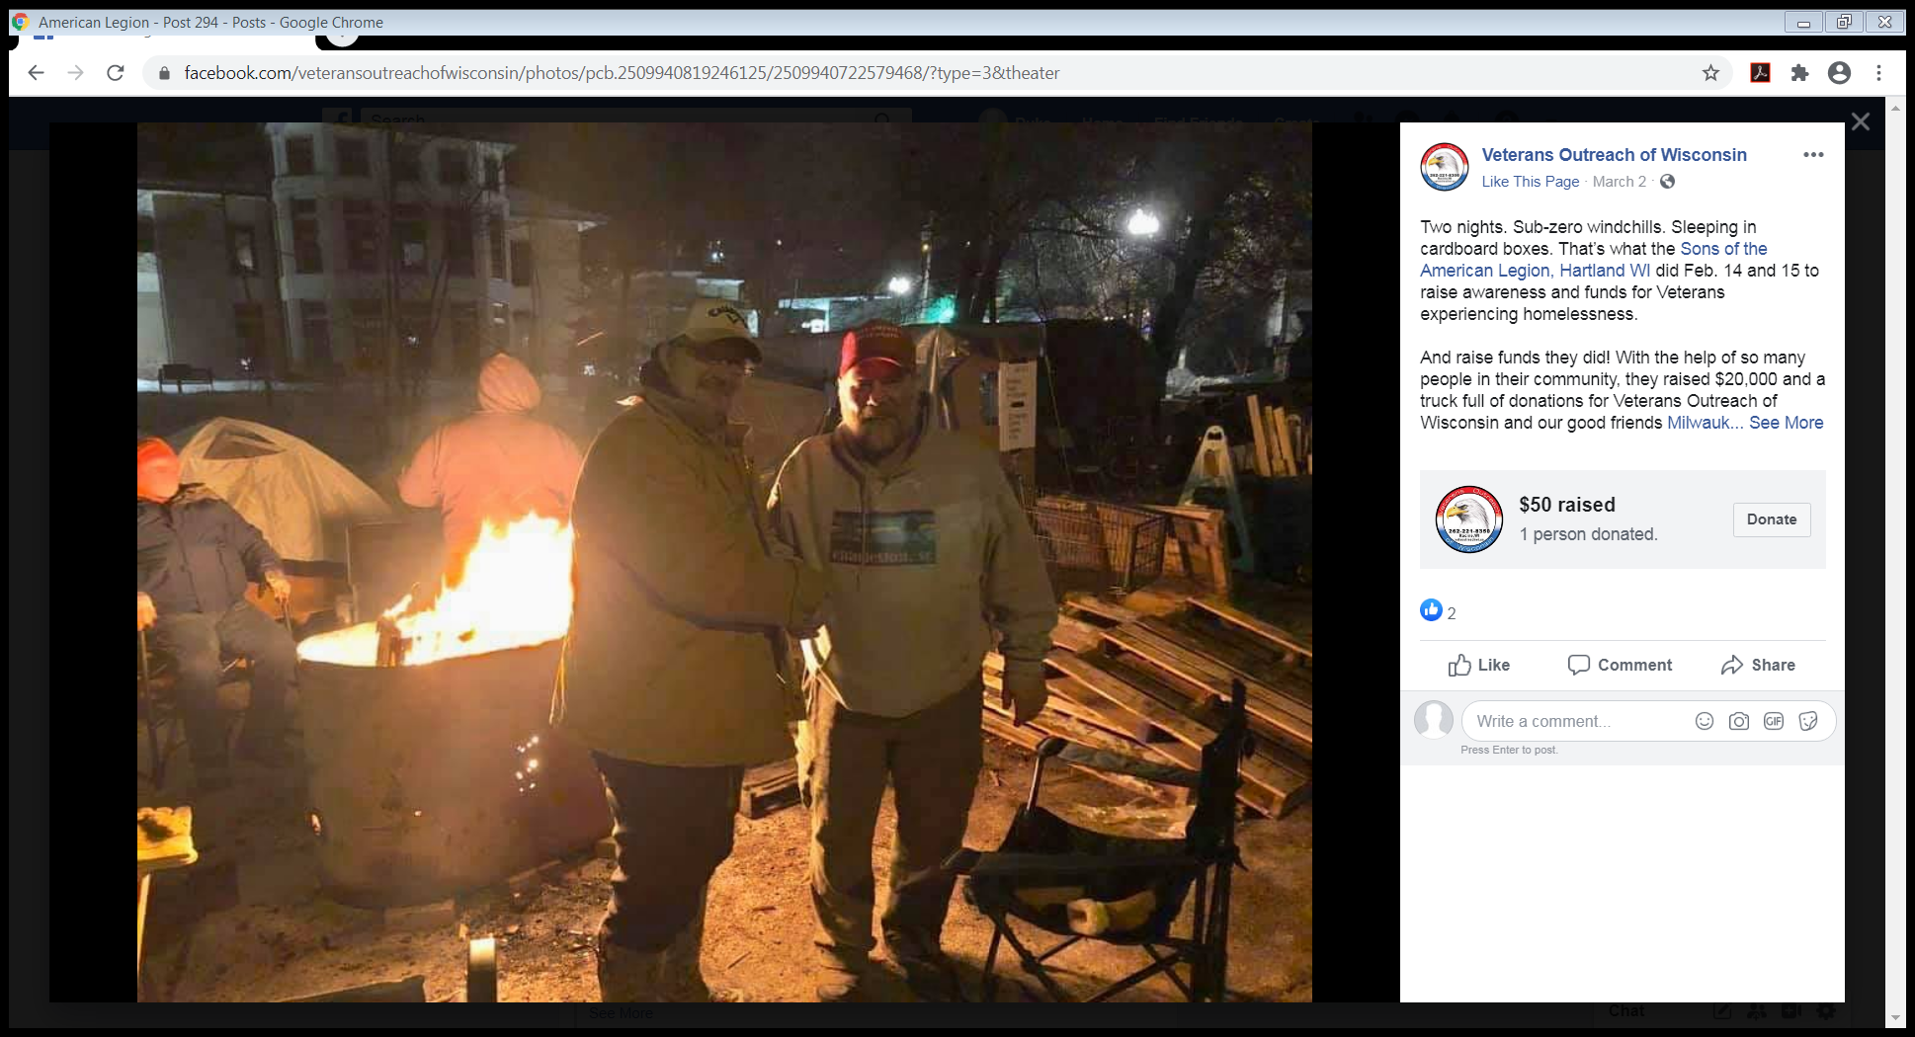

Slide 19
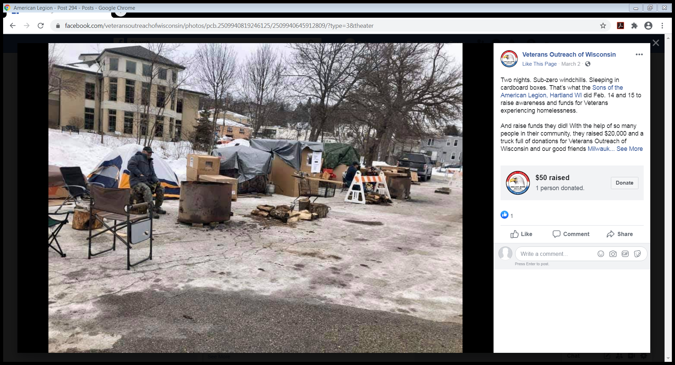

Slide 20
THE AMERICAN LEGION FAMILY IN KANSAS RAISED OVER $45,000 IN TWO SHORT YEARS WITH THEIR “Hold ‘EM for Heroes” event with proceeds going to the veterans community project
.

Slide 21
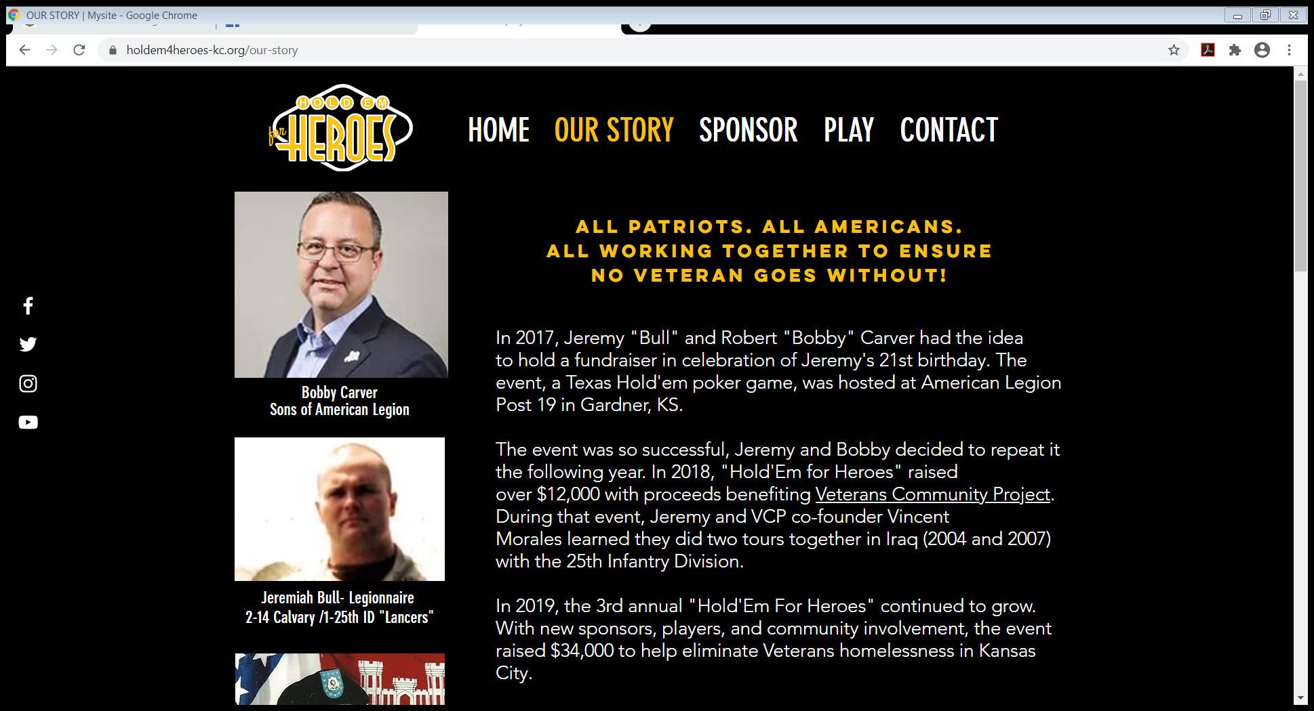

Slide 22
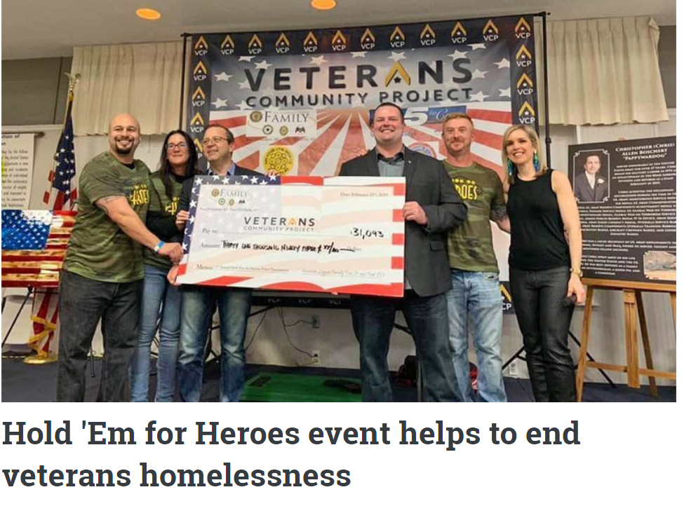

Slide 23
SUGGESTED RESPONSIBILITIES FOR A DETACHMENT VE&E COMMITTEE/COMMISSION
  COORDINATE WITH SAL NATIONAL VE&E COMMISSION
  COORDINATE WITH DEPARTMENT VE&E COMMISSION OR EQUIVALENT (SUCH AS EMPLOYMENT)
  DISSEMINATE INFORMATION PROVIDED BY THE VE&E COMMISSION ON THE STATE AND NATIONAL LEVELS TO DISTRICTS, COUNTIES, SQUADRONS.
  IDENTIFY THE ACTIVE COMMUNITY BASED VETERAN SERVICE ORGANIZATIONS/PROVIDERS IN YOUR AREAS AND THEIR NEEDS.
  EDUCATE YOURSELVES AND YOUR MEMBERS ON VETERANS HOMELESSNESS IN YOUR AREAS SO YOU MAY EDUCATE OTHERS.
  PROMOTE LOCAL BUSINESSES THAT HIRE VETERANS.
  HOLD A FUND RAISER AND MAKE A DONATION TO A VETERAN’S SERVICE ORGANIZATION OR PROVIDER.
  CONTACK LOCAL OFFICIALS TO SEE WHAT IS BEING DONE TO END VETERAN HOMELESSNESS – BECOME AN ADVOCATE.
  IN SHORT THERE ARE NUMEROUS WAYS THAT YOUR DETACHMENT CAN ADVOCATE FOR, ASSIST AND PROMOTE VETERANS EMPLOYMENT AND EDUCATION.

